Slide 1
Bring Your Own iPad (BYO iPad)
The BYO iPad Program at
Beckenham Primary School
Parent Information Session
2024

Slide 2
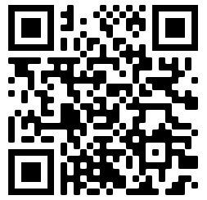
Any Questions? Scan the QR Code on your phone. If you have any questions during the presentation, ask them on your phone via Padlet and they will be answered at the end of the presentation.

Slide 3
What is BYO iPad?
BYO iPad refers to students bringing a personally owned device to school for the purpose of learning.
A personally owned device is any technology device brought into the school and is owned by a student or the student’s family.

Slide 4
Why BYO iPad?
To enhance learning through the use of readily available technology.
Allowing access to devices.
Catering for flexible learning opportunities.
Notes:
Flexible learning is a method of learning where students are given freedom in how, what, when and where they learn. Flexible learning environments address how physical space is used, how students are grouped during learning and how time is used throughout teaching.

Slide 5
Our iPad Program
Why not continue with our current model?
Always Connected
Private & Secure
ICT Skills and efficiency
Promotes Responsible and ethical behaviour
Classroom and home
Notes:
Current model is a bank of 30 library computers, booked out by the teacher.
52 laptops which are also booked out from the library.
6 iPads per classroom.
Chose iPads due to longer battery life of iPads, easy face to face interaction and most importantly teacher can monitor and control student iPads from a teacher iPad through Apple Classroom.
The use of 1:1 devices, as opposed to a shared device model that was used previously at Beckenham Primary School, benefits our students in the following ways:
Always connected and available (no learning time wasted).
Privacy and security associated with using own device.
Consistency of use develops ICT skills and efficiency.
Responsibility and citizenship requirements and expectations.
Continuity between class and home.
Costs associated with having a 1:1 ipad program are prohibitive for the school to finance and cannot happen without this parent contribution.
School is then able to utilise funding for:
Professional learning for staff in digital technologies
Maintenance and improvement of IT infrastructure
Not a cost saving measure for the school but rather one that allows us to provide more opportunities for learning associated with 1:1 device ownership.

Slide 6
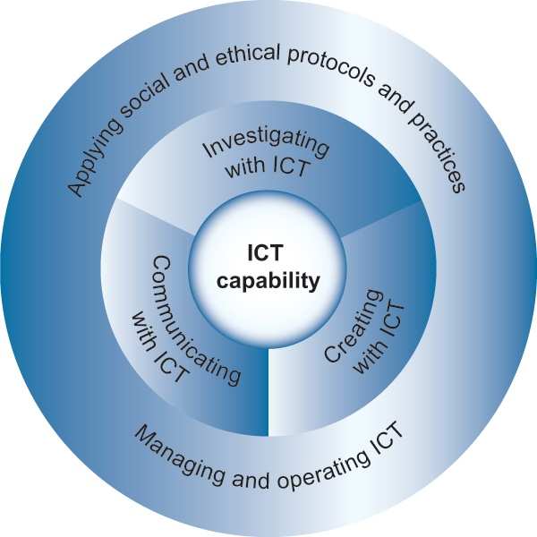
Educational Context
ICT General Capabilities in our Classrooms
The Western Australian Curriculum Information and Communication Technology (ICT) Capability that all teachers integrate across learning areas.
Notes:
The reason for having a BYO iPad program is that it supports the ICT Capability of the curriculum and allows teachers to integrate ICT across all learning areas.
The program that we are implementing is being increasingly adopted by other schools – we are eager to ensure that when entering high school, our students have the IT skills comparable with the other students within our education system. Our students will be ahead of the pack and not left behind.
The Western Australian Curriculum Information and Communication Technology (ICT) Capability that all teachers integrate across learning areas states:
Students develop ICT capability as they learn to use ICT effectively and appropriately to access, create and communicate information and ideas, solve problems and work collaboratively in all learning areas at school, and in their lives beyond school.
The capability involves students in learning to make the most of the digital technologies available to them, adapting to new ways of doing things as technologies evolve and limiting the risks to themselves and others in a digital environment.
To participate in a knowledge-based economy and to be empowered within a technologically sophisticated society now and into the future, students need the knowledge, skills and confidence to make ICT work for them at school, at home, at work and in their communities.
Information and communication technologies are fast and automated, interactive and multimodal, and they support the rapid communication and representation of knowledge to many audiences and its adaptation in different contexts.
They transform the ways that students think and learn and give them greater control over how, where and when they learn.

Slide 7
Our iPad Program
“Anytime, anywhere program”
Individual learning experiences
Common across many WA schools
Voluntary Participation
Years 4 to 6 in 2023
Notes:
The device will be an iPad. The reason we have chosen an iPad is because it is an “anytime, anywhere program” where students are able to use their own personal mobile devices. Helps to provide students with individual learning experiences throughout their classroom activities. Supported by school board, staff and community.
The BYOD program is voluntary. Parents choose whether they would like to participate or not.
Students in Year 4 to 6 (from 2023) will bring a compliant iPad to school to support and enhance their learning.
Reason that we start it in year 4 is because it provides the opportunity for students to work independently and collaboratively.
They are able to learn from a wider range of resources.
Provides opportunity for 3 years of use.

Slide 8
Support for a BYO iPad Program at Beckenham PS
Teacher Survey 2022
Do you perceive BYOD as a valid educational tool?

Slide 9
Support for a BYO iPad Program at Beckenham PS
Parent Survey 1 2022
PP to Year 6 Parents
Would you support a BYOD iPad program at Beckenham Primary School?

Slide 10
Support for a BYO iPad Program at Beckenham PS
Parent Survey 2 2022
Years 3 to Year 5 Parents
Do you support a 1:1 BYOD iPad program for your child entering Years 4 to 6 next year?
Notes:
Current ‘Yes’ results per current year groups
Year 3 83%
Year 4 86%
Year 5 63%

Slide 11
Program Equity
Voluntary
Continue to use shared devices
Shared devices do not go home
The bigger equity question to be considered is whether students at Beckenham Primary School are receiving the same opportunity to access the curriculum as students at other ‘like schools’.
Notes:
Being part of the BYOD program is voluntary – but strongly encouraged.
Students without a device will have access to a suitable shared school devices.
Students accessing shared school devices will not be able to take these devices home.
• Provided alternative project options
• No students will be denied access to the curriculum due to not having a personal device

Slide 12
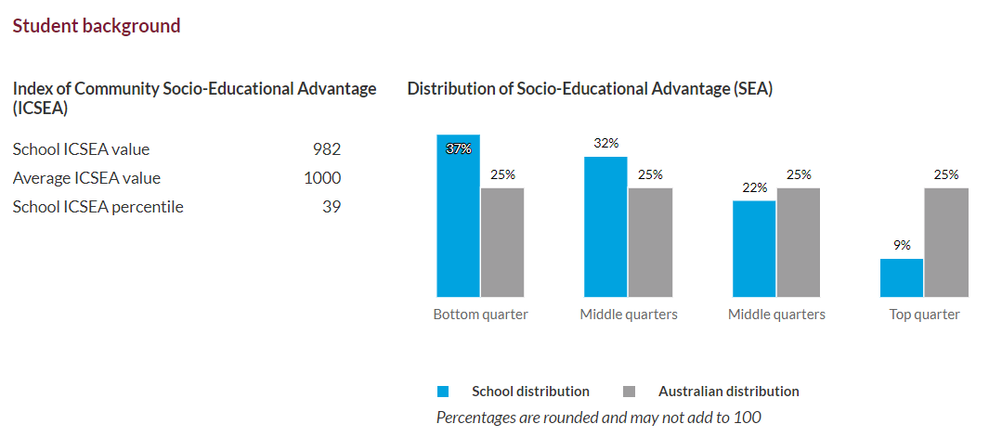
Orange Grove Primary School Year 3 to Year 6 iPad BYOD Program
Notes:
The Index of Community Socio-educational Advantage (ICSEA) is a scale of socioeducational advantage that is computed for each school.
ICSEA enables you to make comparisons between a selected school and all students with a similar background based on the level of educational advantage or disadvantage that students bring to their academic studies.
in addition to the school ICSEA value a histogram presents the distribution of students across four socio-educational advantage (SEA) quarters representing a scale of relative disadvantage ('bottom quarter') through to relative advantage ('top quarter').

Slide 13
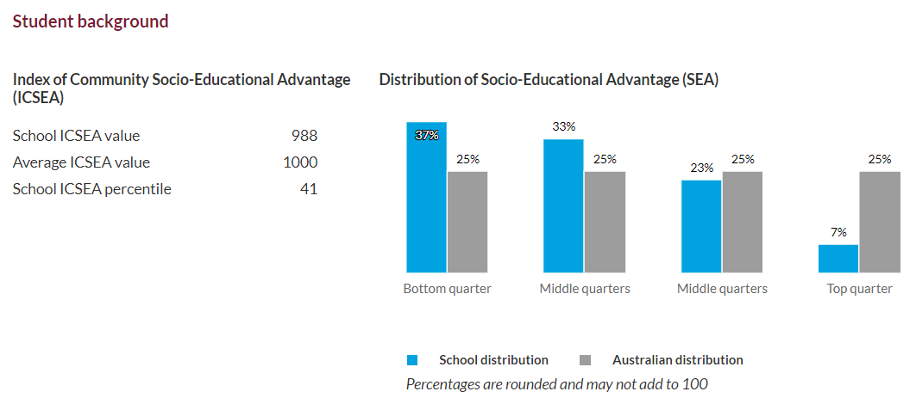
Bertram Primary School Pre-Primary to Year 6 iPad BYOD Program
Notes:
By doing this program, we are able to ensure and cater for our students that when they leave Beckenham and enter high school, they have the IT skills that are comparable with others in our education system and not left behind.

Slide 14
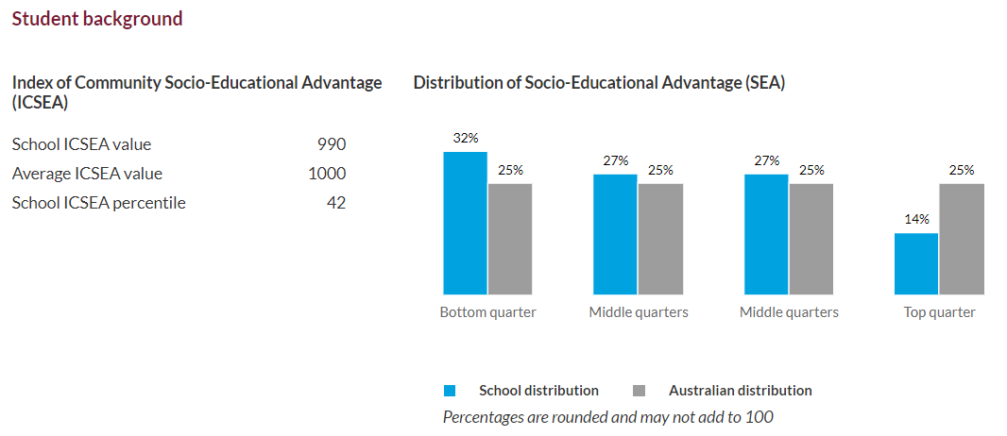
Beckenham Primary School
Notes:
By doing this program, we are able to ensure and cater for our students that when they leave Beckenham and enter high school, they have the IT skills that are comparable with others in our education system and not left behind.

Slide 15
Work Samples
Notes:
In the Years 3-6 Mandarin Language classes, students use iPads to support their language learning in various ways.
Students have been learning how to type Chinese characters, search for information, using Google translate to assist with their speaking and using the Apple applications such as Keynote. We also explore and navigate the functions of the applications together. Often, students discover many new ways to problem-solve.
Samuel from Year 4 has been working on a Keynote presentation about himself.
He decided to include a cultural experience activity in the presentation, which he amalgamated from a separate Keynote presentation. Please enjoy!

Slide 16
Supplying an iPad

Slide 17
Option 1: Winthrop Australia
Beckenham Primary School has partnered with Winthrop Australia to provide iPads at a discounted price to the parent community.
Shop Winthrop Australia (winaust.com.au)
Notes:
Parents are not required to purchase their devices from Winthrop but doing so offers the following benefits:
Discounted educational pricing
Optional two years AppleCare+ extended warranty
Optional two years of insurance
Service and insurance support

Slide 18
Option 2: Source your own device
iPads brought from home
Buy the iPads from another retailer
MINIMUM REQUIREMENTS OF ALL iPads
Can operate the latest iPadOS software
64GB of storage
The iPad mini is not deemed suitable by the Department
Notes:
Anything smaller (or older) that this model may have difficulty in terms of storage and compatibility.
New, or larger iPads will also work effectively and will likely remain compliant for longer.
The iPad mini is not deemed suitable as the size will not be appropriate for online testing such as NAPLAN and PAT testing.

Slide 19
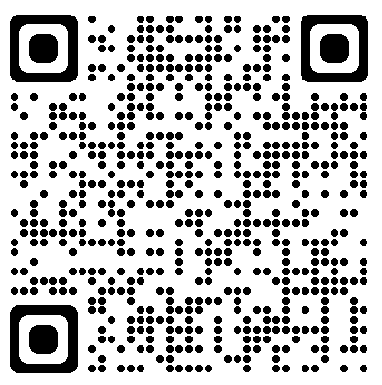
Our iPad Program
Apps and Family Control Cost of apps = $25 max
Apple ID and Family Sharing = Parental Control!
Parent/Carer has full control of their child/ren’s iPad!
Notes:
You will be required to install apps on your child’s iPad while at home for them to participate fully in the 1:1 iPad Program.
There will be a limit on the total cost of $25 and all apps will be chosen after consideration of the SAMR model. Please visit https://appleid.apple.com/ to create an Apple ID if you do not already have one. This is needed to download apps from the App store.
Prior to installing apps on the iPad please create a child account. This will allow you to enable parental controls and keep your information separate from your child’s. Visit https://support.apple.com/en-au/HT201084 for more information.
Initially, many of the apps required will be those that come with the iPad
Safari
Pages
Keynote
iMovie
Notes
Calendar

Slide 20
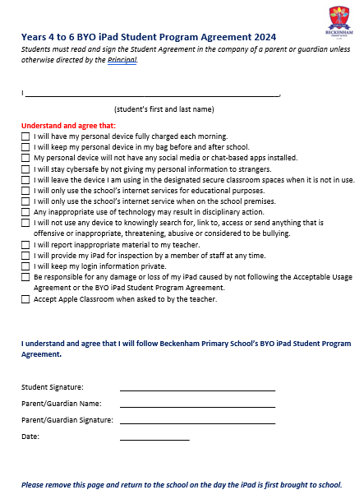
Student Responsibility
Notes:
Bring your iPad to school each day, fully charged.
Do not use your iPad before school, during school breaks or immediately after school, unless directed by your teacher.
Connect to the school Wi-Fi network and enable for use with Apple Classroom, Connect and Office 365.
Use the device only when directed to, fully supervised by a teacher.
Read, understand, and agree to the conditions outlined in the “Online Acceptable Use Agreement for Students in Years 4 to 6”.
Read, understand and agree to the conditions in the “Years 4-6 BYOD Student Program Agreement 2023”
Treat your iPad with respect to ensure that it continues to function effectively.

Slide 21
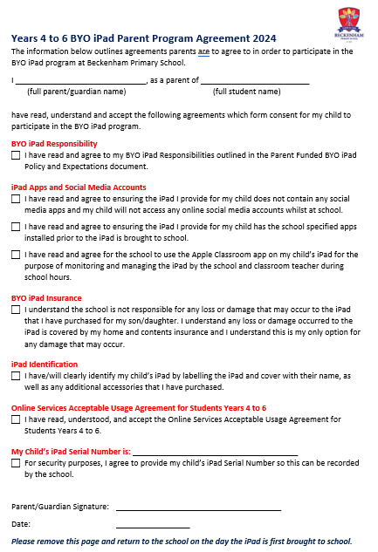
Parent Responsibility
Notes:
Help to ensure students have their iPad at school each day and they are in a suitable condition for use in the classroom. This includes having the iPad fully charged each day.
Ensure frequent Automatic or Manual updates occur for apps and the device.
Setup an iTunes account to add required apps. For assistance, please click HERE or follow this link: http://appleid.apple.com/
Accept responsibility for costs involved in the purchase and insurance of your child’s iPad. Apple Family Sharing can be used to maximise the benefit of app purchases.
Remove inappropriate games and social media apps from the iPads prior to the iPad being brought to school to use in the classroom.
Supervise the use of technology when in the home and establish limits of use such as screen time and app limits.
Make sure that the iPad is clearly labelled along with additional accessories.
Ensure external internet capabilities are disabled to allow the use of the school’s Wi-Fi network.
Support the school in maintaining the safety of all students when online – both at school and home.
Read, understand, and agree to the conditions outlined in the “Online Acceptable Use Agreement for Students in Years 4 to 6”.
Read, understand and agree to the conditions in the “Years 4-6 BYOD Parent Program Agreement 2023”

Slide 22
School Responsibility
Staff Training
Provide cyber safety
Provide effective Wi-Fi and infrastructure
Integrate ICT into the curriculum
Provide safe storage during the day and closely monitor use.
Deliver the Digital Technologies curriculum
Communicate with families to demonstrate how iPads are supporting learning and providing unique opportunities
Notes:
Ensure that staff receive professional learning and training in suitable apps that address the transformation stage of the SAMR Model.
Provide cyber safety resources for parents and students.
Provide effective Wi-Fi and infrastructure to maximise opportunities for learning.
Integrate iPads into the curriculum where it can support learning, practice concepts and aid research. The 1:1 BYOD program will not replace or substitute explicit teaching of key subject areas, nor the development of handwriting skills.
Provide safe storage during the day and closely monitor use.
If an iPad is left behind at school, ensure the iPad is kept in a secure location overnight.
Communicate with families to demonstrate how iPads are supporting learning and providing unique opportunities.

Slide 23
Thank you
Question time
https://padlet.com/clairebaxtrem/8g46zvgwrb9x18gt

